Slide 1
Hinrich Schütze and Christina Lioma
Lecture 20: Crawling

Slide 2
Overview
Recap
A simple crawler
A real crawler

Slide 3
Outline
Recap
A simple crawler
A real crawler

Slide 4
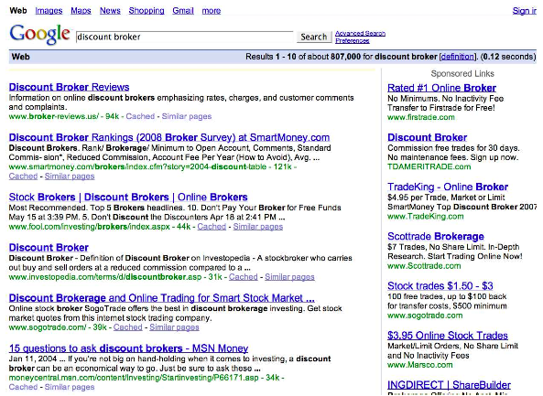
Search engines rank content pages and ads
4

Slide 5
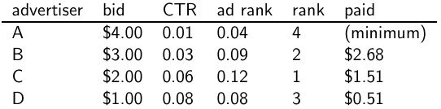
Google’s second price auction
bid: maximum bid for a click by advertiser
CTR: click-through rate: when an ad is displayed, what percentage of time do users click on it? CTR is a measure of relevance.
ad rank: bid × CTR: this trades off (i) how much money the advertiser is willing to pay against (ii) how relevant the ad is
paid: Second price auction: The advertiser pays the minimum amount necessary to maintain their position in the auction (plus 1 cent).
5

Slide 6
What’s great about search ads
Users only click if they are interested.
The advertiser only pays when a user clicks on an ad.
Searching for something indicates that you are more likely to buy it . . .
. . . in contrast to radio and newpaper ads.
6

Slide 7
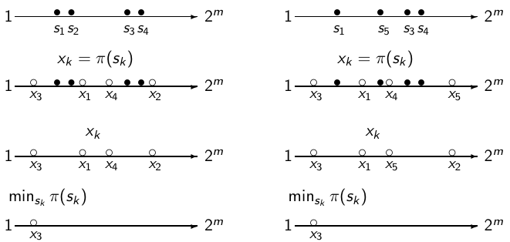
Near duplicate detection: Minimum of permutation
document 1: {s_{k}} document 2: {s_{k}}
Roughly: We use as a test for: are d₁ and d₂ near-duplicates?
7

Slide 8
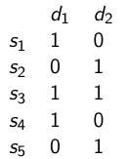
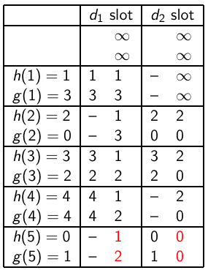
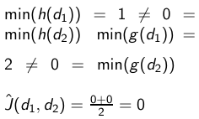
Example
h(x) = x mod 5
g(x) = (2x + 1) mod 5
final sketches
8

Slide 9
Outline
Recap
A simple crawler
A real crawler

Slide 10
How hard can crawling be?
Web search engines must crawl their documents.
Getting the content of the documents is easier for many other IR systems.
E.g., indexing all files on your hard disk: just do a recursive descent on your file system
Ok: for web IR, getting the content of the documents takes longer . . .
. . . because of latency.
But is that really a design/systems challenge?
10

Slide 11
Basic crawler operation
Initialize queue with URLs of known seed pages
Repeat
Take URL from queue
Fetch and parse page
Extract URLs from page
Add URLs to queue
Fundamental assumption: The web is well linked.
11

Slide 12
Exercise: What’s wrong with this crawler?
urlqueue := (some carefully selected set of seed urls)
while urlqueue is not empty:
myurl := urlqueue.getlastanddelete()
mypage := myurl.fetch()
fetchedurls.add(myurl)
newurls := mypage.extracturls()
for myurl in newurls:
if myurl not in fetchedurls and not in urlqueue:
urlqueue.add(myurl)
addtoinvertedindex(mypage)
12

Slide 13
What’s wrong with the simple crawler
Scale: we need to distribute.
We can’t index everything: we need to subselect. How?
Duplicates: need to integrate duplicate detection
Spam and spider traps: need to integrate spam detection
Politeness: we need to be “nice” and space out all requests for a site over a longer period (hours, days)
Freshness: we need to recrawl periodically.
Because of the size of the web, we can do frequent recrawls only for a small subset.
Again, subselection problem or prioritization
13

Slide 14
Magnitude of the crawling problem
To fetch 20,000,000,000 pages in one month . . .
. . . we need to fetch almost 8000 pages per second!
Actually: many more since many of the pages we attempt to crawl will be duplicates, unfetchable, spam etc.
14

Slide 15
What a crawler must do
Be polite
Don’t hit a site too often Only crawl pages you are allowed to crawl: robots.txt
Be robust
Be immune to spider traps, duplicates, very large pages, very large websites, dynamic pages etc
15

Slide 16
Robots.txt
Protocol for giving crawlers (“robots”) limited access to a website, originally from 1994
Examples:
User-agent: *
Disallow: /yoursite/temp/
User-agent: searchengine
Disallow: /
Important: cache the robots.txt file of each site we are crawling
16

Slide 17
Example of a robots.txt (nih.gov)
User-agent: PicoSearch/1.0
Disallow: /news/information/knight/
Disallow: /nidcd/
...
Disallow: /news/research_matters/secure/
Disallow: /od/ocpl/wag/
User-agent: *
Disallow: /news/information/knight/
Disallow: /nidcd/
...
Disallow: /news/research_matters/secure/
Disallow: /od/ocpl/wag/
Disallow: /ddir/
Disallow: /sdminutes/
17

Slide 18
What any crawler should do
Be capable of distributed operation
Be scalable: need to be able to increase crawl rate by adding more machines
Fetch pages of higher quality first
Continuous operation: get fresh version of already crawled pages
18

Slide 19
Outline
Recap
A simple crawler
A real crawler

Slide 20
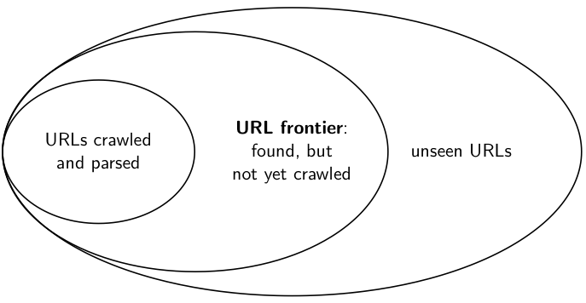
URL frontier
20

Slide 21
URL frontier
The URL frontier is the data structure that holds and manages URLs we’ve seen, but that have not been crawled yet.
Can include multiple pages from the same host
Must avoid trying to fetch them all at the same time
Must keep all crawling threads busy
21

Slide 22
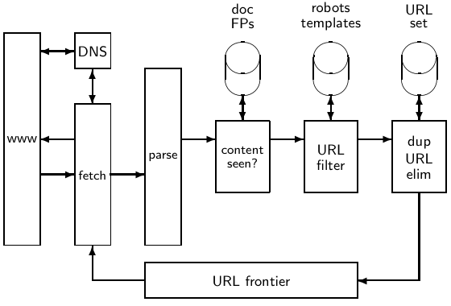
Basic crawl architecture
22

Slide 23
URL normalization
Some URLs extracted from a document are relative URLs.
E.g., at http://mit.edu, we may have aboutsite.html
This is the same as: http://mit.edu/aboutsite.html
During parsing, we must normalize (expand) all relative URLs.
23

Slide 24
Content seen
For each page fetched: check if the content is already in the index
Check this using document fingerprints or shingles
Skip documents whose content has already been indexed
24

Slide 25
Distributing the crawler
Run multiple crawl threads, potentially at different nodes
Usually geographically distributed nodes
Partition hosts being crawled into nodes
25

Slide 26
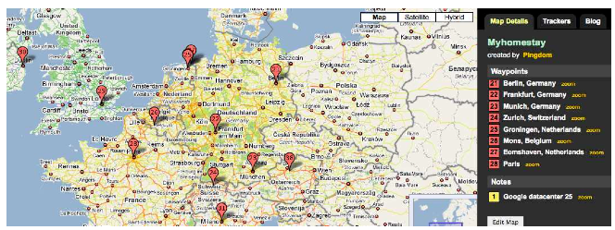
Google data centers (wazfaring. com)
26

Slide 27
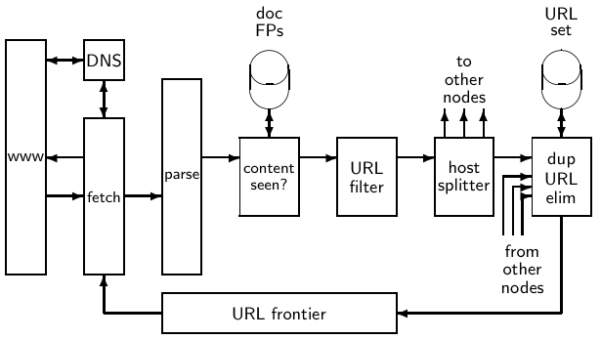
Distributed crawler
27

Slide 28
URL frontier: Two main considerations
Politeness: Don’t hit a web server too frequently
E.g., insert a time gap between successive requests to the same server
Freshness: Crawl some pages (e.g., news sites) more often than others
Not an easy problem: simple priority queue fails.
28

Slide 29
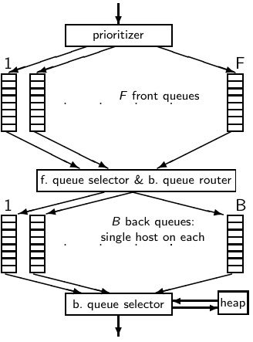
Mercator URL frontier
29

Slide 30
Mercator URL frontier
URLs flow in from the top into the frontier.
30

Slide 31
Mercator URL frontier
URLs flow in from the top into the frontier.
Front queues manage prioritization.
31

Slide 32
Mercator URL frontier
URLs flow in from the top into the frontier.
Front queues manage prioritization.
Back queues enforce politeness.
32

Slide 33
Mercator URL frontier
URLs flow in from the top into the frontier.
Front queues manage prioritization.
Back queues enforce politeness.
Each queue is FIFO.
33

Slide 34
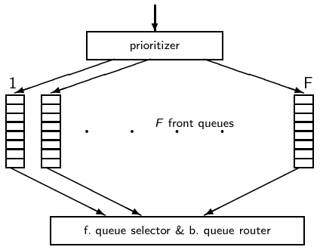
Mercator URL frontier: Front queues
34

Slide 35
Mercator URL frontier: Front queues
Prioritizer assigns to URL an integer priority between 1 and F.
35

Slide 36
Mercator URL frontier: Front queues
Prioritizer assigns to URL an integer priority between 1 and F.
Then appends URL to corresponding queue
36

Slide 37
Mercator URL frontier: Front queues
Prioritizer assigns to URL an integer priority between 1 and F.
Then appends URL to corresponding queue
Heuristics for assigning priority: refresh rate, PageRank etc
37

Slide 38
Mercator URL frontier: Front queues
Selection from front queues is initiated by back queues
Pick a front queue from which to select next URL: Round robin, randomly, or more sophisticated variant
But with a bias in favor of high-priority front queues
38

Slide 39
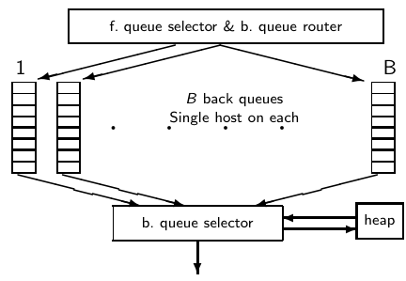
Mercator URL frontier: Back queues
39

Slide 40
Mercator URL frontier: Back queues
Invariant 1. Each back queue is kept non-empty while the crawl is in progress.
Invariant 2. Each back queue only contains URLs from a single host.
Maintain a table from hosts to back queues.
40

Slide 41
Mercator URL frontier: Back queues
In the heap:
One entry for each back queue
The entry is the earliest time t_{e} at which the host corresponding to the back queue can be hit again.
The earliest time t_{e} is determined by (i) last access to that host (ii) time gap heuristic
41

Slide 42
Mercator URL frontier: Back queues
How fetcher interacts with back queue:
Repeat (i) extract current root q of the heap (q is a back queue)
and (ii) fetch URL u at head of q . . .
. . . until we empty the q we get.
(i.e.: u was the last URL in q)
42

Slide 43
Mercator URL frontier: Back queues
When we have emptied a back queue q:
Repeat (i) pull URLs u from front queues and (ii) add u to its corresponding back queue . . .
. . . until we get a u whose host does not have a back queue.
Then put u in q and create heap entry for it.
43

Slide 44
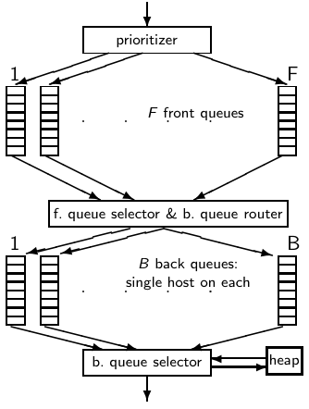
Mercator URL frontier
URLs flow in from the top into the frontier.
Front queues manage prioritization.
Back queues enforce politeness.
44

Slide 45
Spider trap
Malicious server that generates an infinite sequence of linked pages
Sophisticated spider traps generate pages that are not easily identified as dynamic.
45

Slide 46
Resources
Chapter 20 of IIR
Resources at http://ifnlp.org/ir
Paper on Mercator by Heydon et al.
Robot exclusion standard
46

